Slide 1

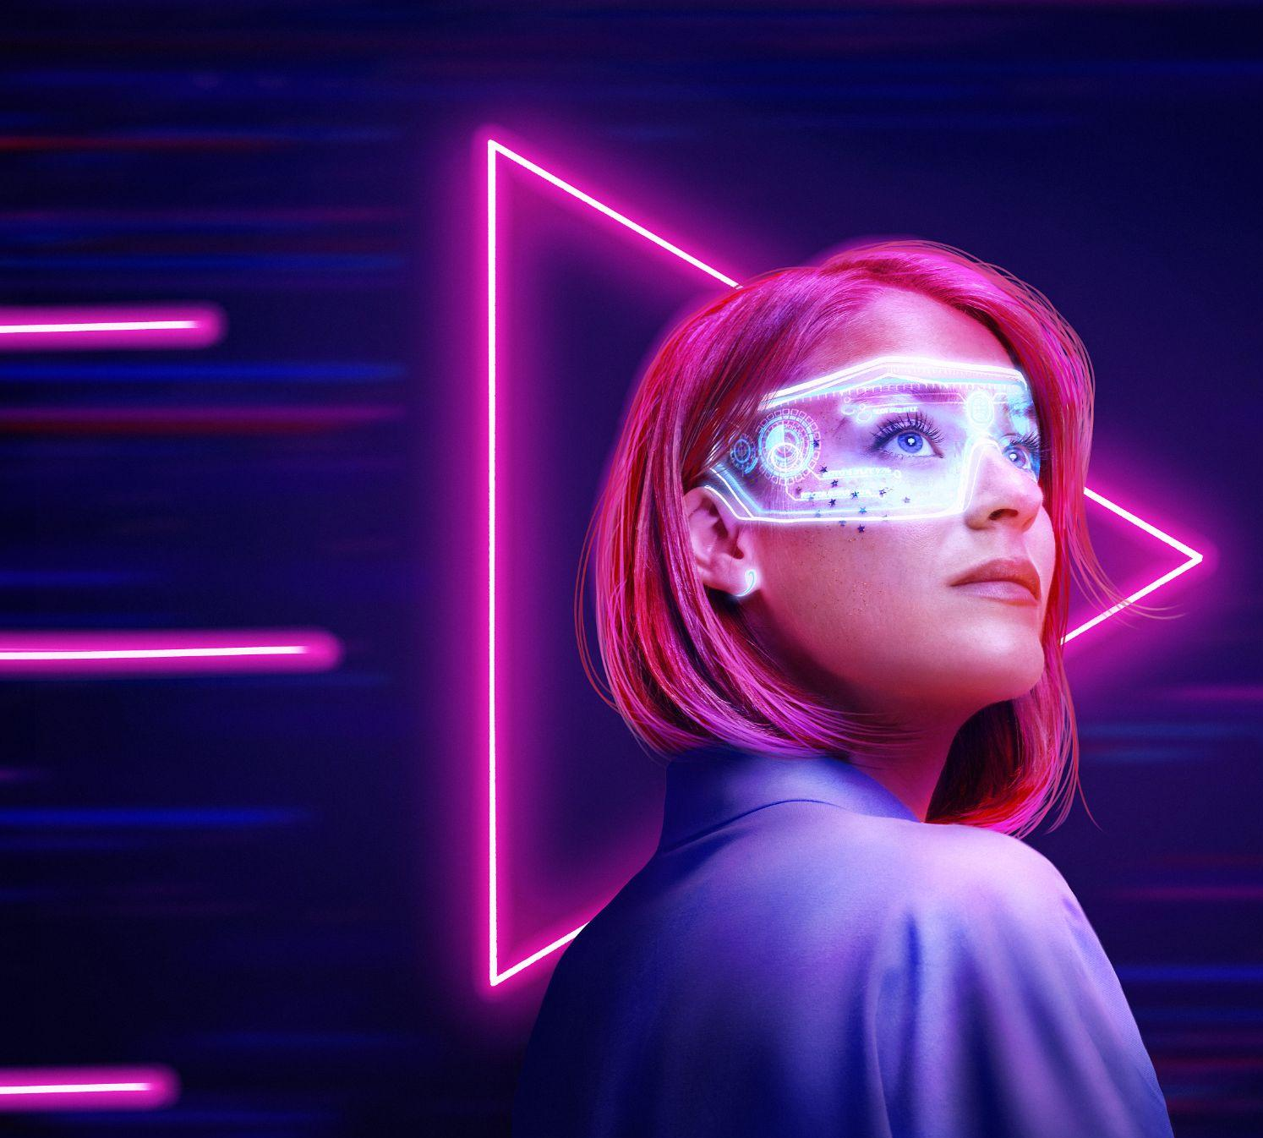


Future Technologies
Moskovets Stepan, ICS7 - 43

Slide 2
The Future is Here
The future is now if the following technologies are any indication. These breakthroughs will change our world in ways we can’t even imagine. These innovations will soon be a reality.

Slide 3
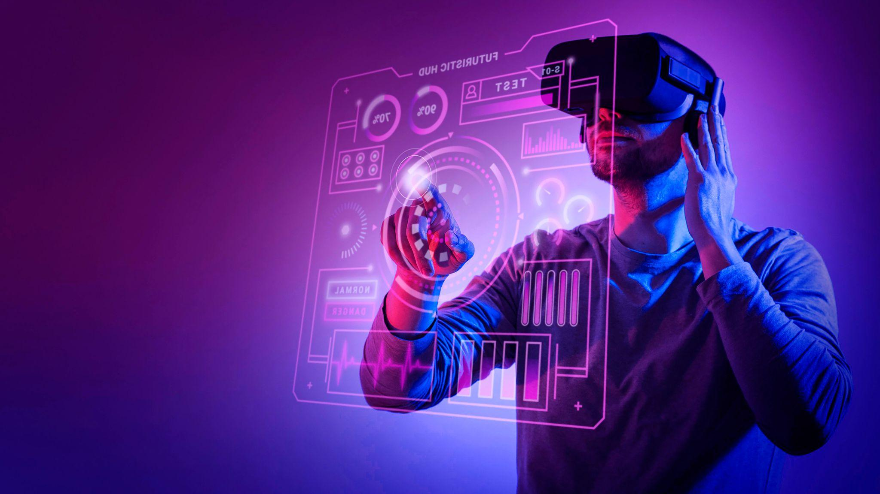
Virtual Reality
Virtual Reality (VR) is a computer-generated simulation of a three-dimensional image or environment that can be interacted with in a seemingly natural or physical way. There are many uses for VR
Gaming
Healthcare
Education
Shopping

Slide 4
Internet of Things
Internet of Things, or IoT, refers to the broadband of physical objects to the Internet. The goal is to have all objects on our planet connected to the Internet to communicate with one another and exchange information.

Slide 5
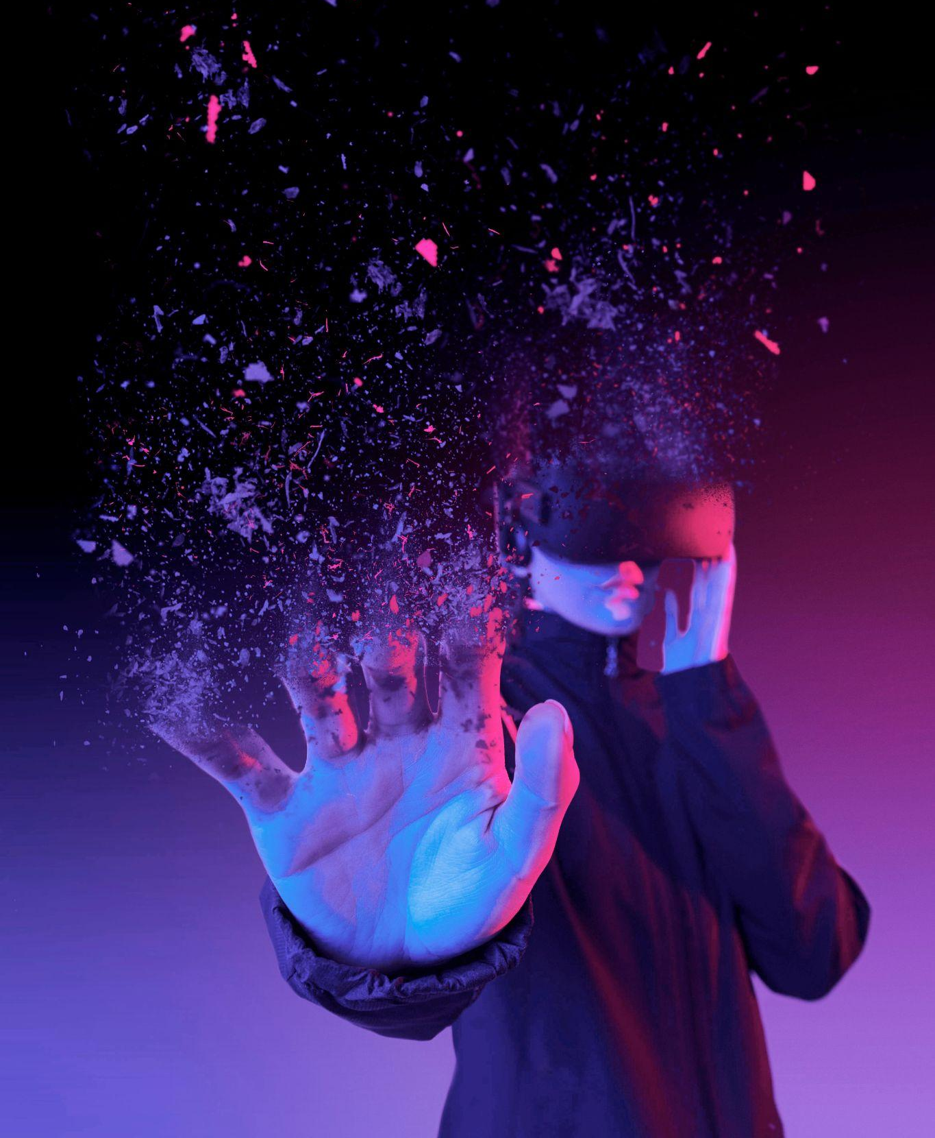
Connecting with Quantum Entanglement
A quantum computer would have exponentially more processing power than any of today’s computers and would be able to do things like break encryption and reconstruct a hologram.

Slide 6
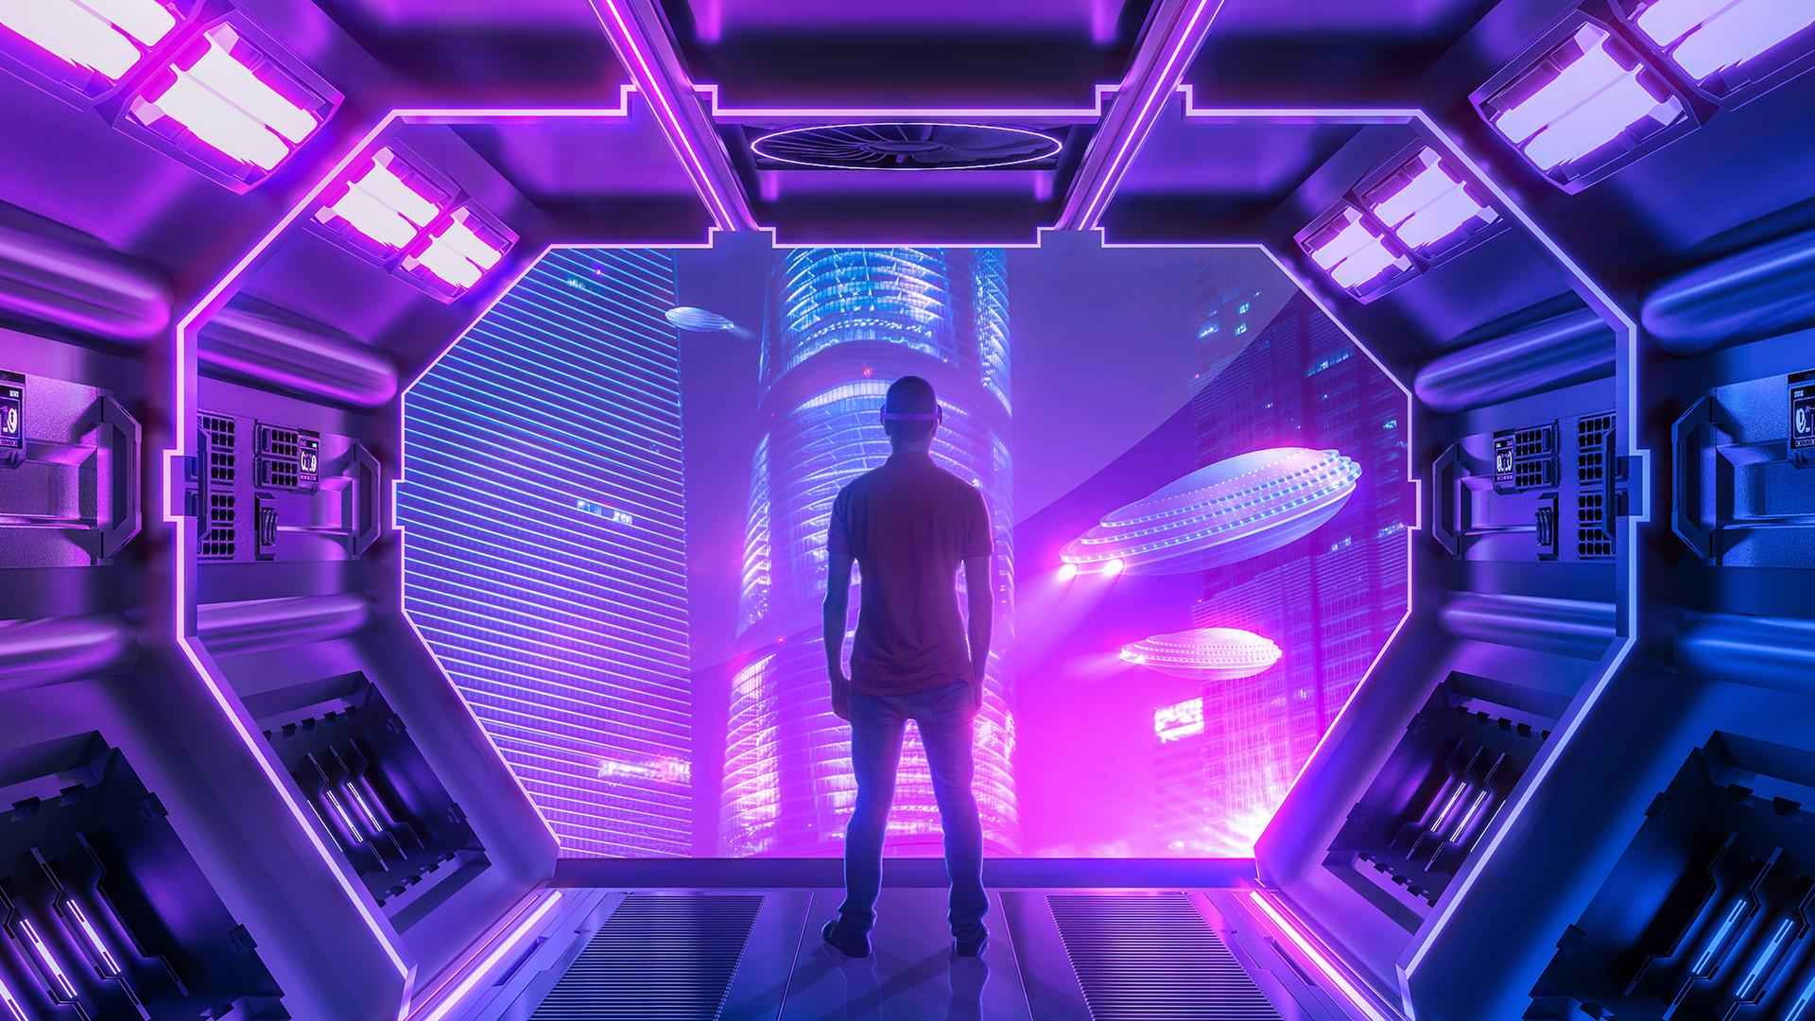
Thank you for your attention

